Slide 1
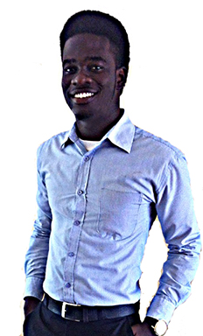

-Web developer: Programs in: (JS, jQuery, MySQL, PHP, AJAX) - Software developer: Programs in: C++, C#, JAVA, Visual Basic, Python -electrical engineer
-Me in 3 years...
MR. BLANKSON-AFFUL
CEO /BIT DISTRIKT

